Slide 1
CAPSTONE PRESENTATION
Thinkful
Data Analytics Immersion
Cohort 5
Police and Population Inquiry
Presented by: Preshess Jones

Slide 2
OUTLINE
2016 Police and Population Overview
Assumptions about the data
Statistical Test Results
Recommendations

Slide 3

Questions?
Please, feel free to ask questions as they come up.

Slide 4
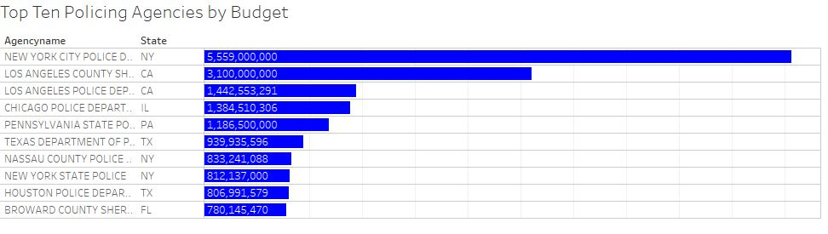
Overview States and agencies

Slide 5
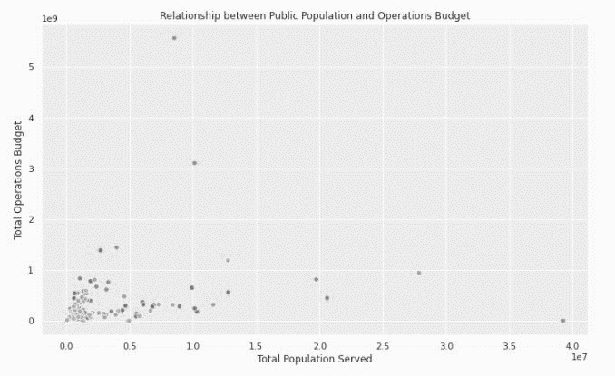

Overview Budgets by state and agency
New York City Police
Department
$5,559,000,000
CALIFORNIA HIGHWAYPATROL
$ 39,250,017

Slide 6
Assumption OVERVIEW
Assumption #1 | Assumption #2 | Assumption #3
States with the lowest use of psychological interviews within the hiring process have the highest budgets | Personnel within police agencies do not accurately represent the populations they serve | Agencies with the highest diversity have the lowest budgets

Slide 7
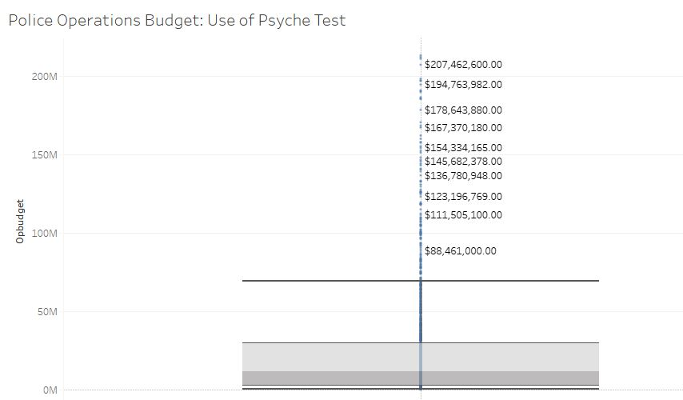
Assumption #1 -A States with the lowest use of psychological interviews within the hiring process have the highest budgets

Slide 8
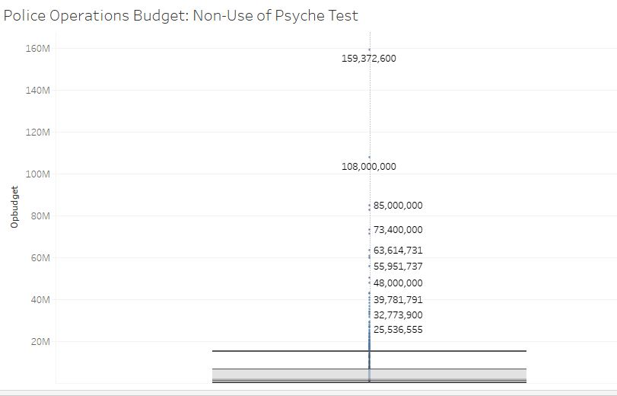
Assumption #1 - B States with the lowest use of psychological interviews within the hiring process have the highest budgets

Slide 9
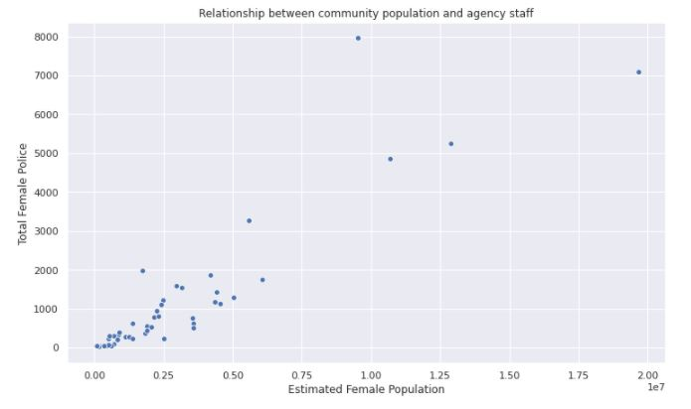
Assumption #2 Personnel within police agencies do not accurately represent the populations they serve
United States. Bureau of Justice Statistics. Census of Federal Law Enforcement Officers (CFLEO), [United States], Fiscal Year 2016. Inter-university Consortium for Political
and Social Research [distributor], 2020-03-24. https://doi.org/10.3886/ICPSR37607.v1
U.S. Census Bureau, 2016 American Community Survey 1-Year Estimates https://data.census.gov/

Slide 10
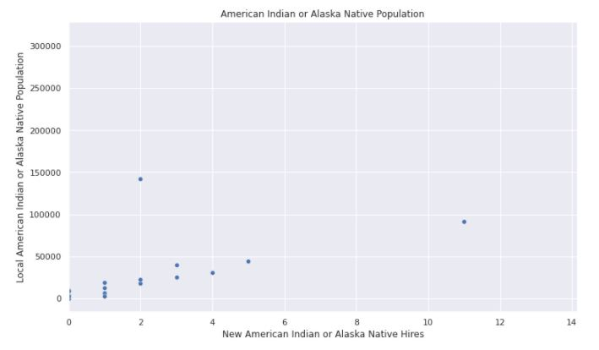
Assumption #3 Agencies with the highest diversity have the lowest budgets

Slide 11
Recommendations
Given the data…
Not significant variables to determine
Not likely findings result in correlations
Use of psyche tests in the hiring process and total operations budget: possible positive relationship
Further analysis, given more thorough data, is recommended.
Additional data should represent qualitative and quantitative information expanding from self reported data and include union data.
View Jupiter Notebook

Slide 12
Roadmap
Gather agency demo data
Tag vehicles in fleet to be phased out
Clean data
Re-test hypotheses
Assess for patterns
Increase sales through new branch
Donate Vehicles

Slide 13
Contact Me
LinkedIn PreshessJones
Instagram @JustP_resh
Email Preshess@quriocity.design
Phone 971-258-0951

